Slide 1

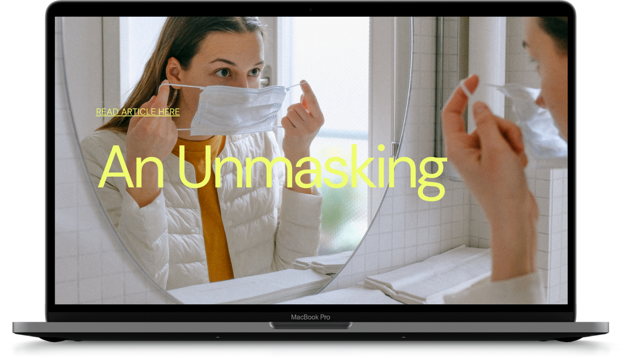
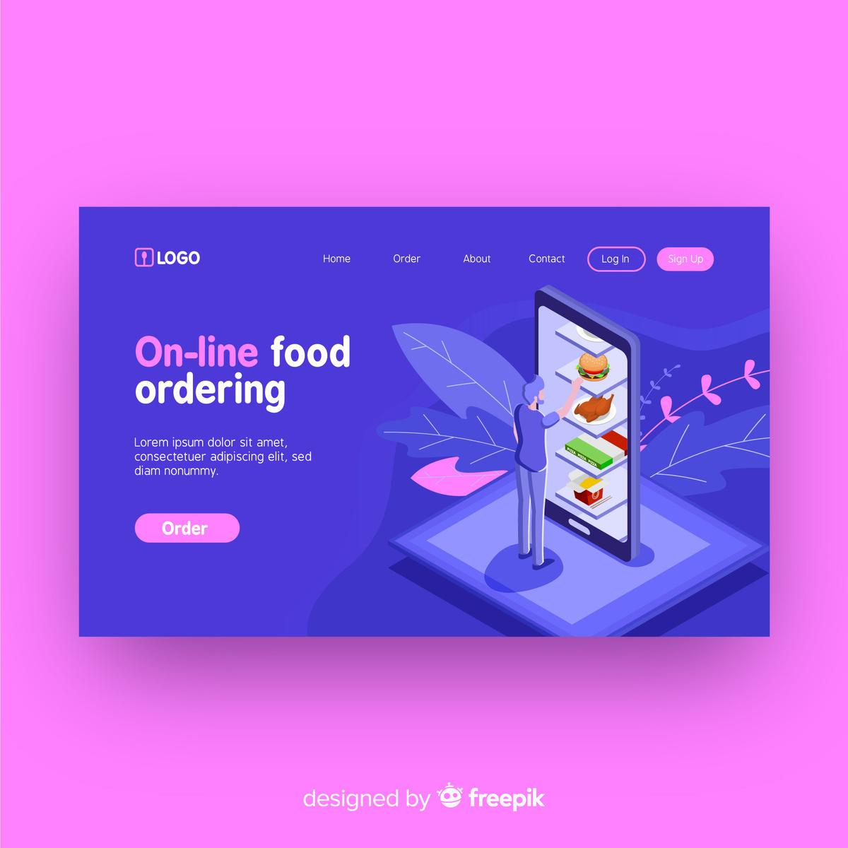



Unilever Canteen Ordering System Project
CANTEEN
ORDERING
SYSTEM
BY THE INNOVATORS TEAM

Slide 2

Table of Content
Company Overview
03
Unilever Canteen Ordering System Dev.
21
Stakeholder Identification and Analysis
04
RACI Matrix
22
Stakeholder Analysis Matrix
05
Main software features to be developed
23
Stakeholder Analysis and justification
06-08
As-Is Process map
24
To-Be process map
Business Case
09
25
Executive Summary
10
Unilever User Stories
26-27
Current implementation
10
Jira Sprints and Timelines
Problems Identified
11
28
JIRA sprints
29
Project Objectives
12
JIRA timeline
Finding New Implementation
13
30
Our Team
31
Review of Options
14
Possible Vendors
15
Benefits of Canteen Ordering System
16
Key Performance Indicators
17
Implementation Risks
18
Suggested Vendor Overview
19
Conclusion
20

Slide 3
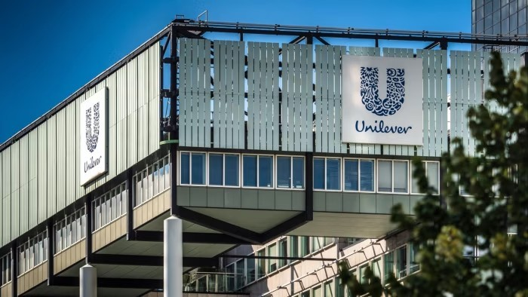
Company Overview
Unilever is a British-Dutch FMCG company, headquartered in London, England. Unilever is one of the oldest
FMCG companies, and its products are available in around 190 countries.
In its UK offices, Unilever has around 1500 employees which are spread across 12 floors. They have 2 canteens
to cater to these 1500 employees. Each canteen can seat around 150 employees at a time.

Slide 4

Stakeholder Identification and Analysis

Slide 5
STAKEHOLDER ANALYSIS MATRIX
Keep Satisfied Regulatory bodies Internal compliance officer Legal Officer | Key Players IT Department Menu manager Procurement Developer Tester Canteen Manager HR Manager Payroll Manager Senior Management
Monitor Canteen Owner | Keep Informed Employees Chefs/Canteen Staff Delivery Personnel
High
Influence
Low
Low
Interest
High

Slide 6
STAKEHOLDER ANALYSIS AND JUSTIFICATION
Stakeholder | Interest | Influence | Classification | Engagement Strategy | Justification
Employees (End Users) | High | Low | Keep Informed | Involve in user testing, regular feedback sessions | They will be the primary users of the system, so their satisfaction is crucial for the project's success.
Canteen Manager | High | High | Key Players | Regular updates involve in decision-making | Responsible for overseeing the canteen operations, including menu management and order processing.
Chefs/Canteen Staff | High | Low | Keep informed | Training sessions, involve in system design decisions related to food preparation | Their role is critical in ensuring timely preparation and quality of food ordered through the system.
Delivery Personnel | High | Low | Keep Informed | Training on system usage, regular briefings | Responsible for delivering the food to employees, ensuring timely and accurate deliveries.

Slide 7
STAKEHOLDER ANALYSIS AND JUSTIFICATION (Contd.)
Stakeholder | Interest | Influence | Classification | Engagement Strategy | Justification
Regulatory Bodies | Low | High | Keep Satisfied | Compliance checks, regular updates | Ensuring that the system complies with local regulations, particularly in terms of payroll and data management.
IT Department | High | High | Key Player | Technical consultations, ongoing support and system maintenance | They will implement and maintain the ordering system, so their technical input and ongoing support are essential
Payroll Manager | High | High | Key Player | Integration meetings, ensure smooth salary deduction process | Responsible for payroll deductions based on the orders placed by employees, ensuring smooth integration with the payroll system.
Senior Management (Project Sponsor) | High | High | Key Player | Regular status reports, involve in major decision-making | They sponsor the project, and their buy-in is essential for resource allocation and project approval.

Slide 8
STAKEHOLDER ANALYSIS AND JUSTIFICATION (Contd.)
Stakeholder | Interest | Influence | Classification | Engagement Strategy | Justification
Developer | High | High | Key Player | Scrum ceremonies | Key actor in system development and systems integration
Tester | High | High | Key player | Scrum ceremonies | Key actor in testing the system for bugs and defects.
Legal Officer | Low | High | Keep Satisfied | Consulted on legal aspects, compliance checks | Lawyers provide legal advice and support to project team
Procurement | High | High | Key Players | Consulted in initial phase of project planning | Drafting, reviewing, and negotiating contracts with software vendors, consultants, and third-party service providers.
HR Manager | High | HIgh | Key player | Implementation meetings, support IT team with trainings. | Consulted on employee related matters. Supports in providing training to end users
Compliance Officer | Low | High | Keep Satisfied | Consulted on compliance requirements, Compliance checks | Ensures the system complies with internal standards and regulations.

Slide 9


Business Case

Slide 10

Executive Summary
This business case devices the justification for implementing an online canteen ordering system at Unilever’s UK office to address the current inefficiencies in the canteen operations. By adopting this system, Unilever will improve employee satisfaction, improve productivity, reduce food wastage, and optimize canteen operations.
Current Implementation
Most employees would prefer to take their lunch between 12 noon to 1 pm. This has led to a huge rush in the canteen during lunch hours resulting in employees wasting a lot of time waiting for tables to be vacant. Management calculated that it took around 60 minutes for employees to go and come back from lunch. Almost 30-35 minutes were wasted in waiting in a queue to collect their food and get a table to sit and eat. However, the time spent eating was barely 10-15 minutes. The remaining 10 minutes were spent reaching and coming back from the canteen using the elevators.
Employees don’t always get the choice of food they want because the canteen runs out of certain items. The canteen wastes a significant quantity of food by throwing away what is not purchased.
Many employees have requested a system that would permit a canteen user to order meals online, to be delivered to their work location at a specified time and date.

Slide 11

Problems Identified with the Current Process
The existing process in the Unilever canteen has several inefficiencies and challenges that need to be addressed.
Long Waiting Times: Employees waste a significant portion of their lunch break waiting in lines for food. The total time spent on lunch averages 60 minutes, with only 10-15 minutes spent eating. The remaining time is mostly consumed by queuing for food and waiting for tables to become available.
Limited Canteen Space: The canteen has limited seating capacity (150 seats per canteen for 1500 employees). During peak lunch hours (12 noon to 1 pm), this results in overcrowding, leading to a stressful dining environment and further delays.
1
Operational Inefficiencies
Inconsistent Food Availability: Due to the unpredictability of demand, certain food items run out quickly, leaving employees with limited or undesired choices. This inconsistency leads to dissatisfaction among employees who do not get the meal they prefer.
Limited Lunch Break Utility: Employees spend a disproportionate amount of their break time on non-eating activities like queuing and finding a seat, leaving them with less time to relax and enjoy their meals. This can negatively impact their productivity for the rest of the day.
Employee Dissatisfaction
2
Overproduction of least preferred food ; The canteen often prepares more food than is consumed, leading to significant waste. Without a system to predict demand accurately, the canteen staff may overestimate the number of meals needed, resulting in leftover food that is thrown away. For instance, the canteen would waste a lot of Vegetarian food as a result of low demand in vegetarian dishes
3
Food Wastage
The lack of data-driven inventory management in the current system does not allow for accurate tracking of food inventory based on actual orders. This inefficiency in inventory management contributes to both food shortages and wastage.
4
Poor Inventory Management

Slide 12
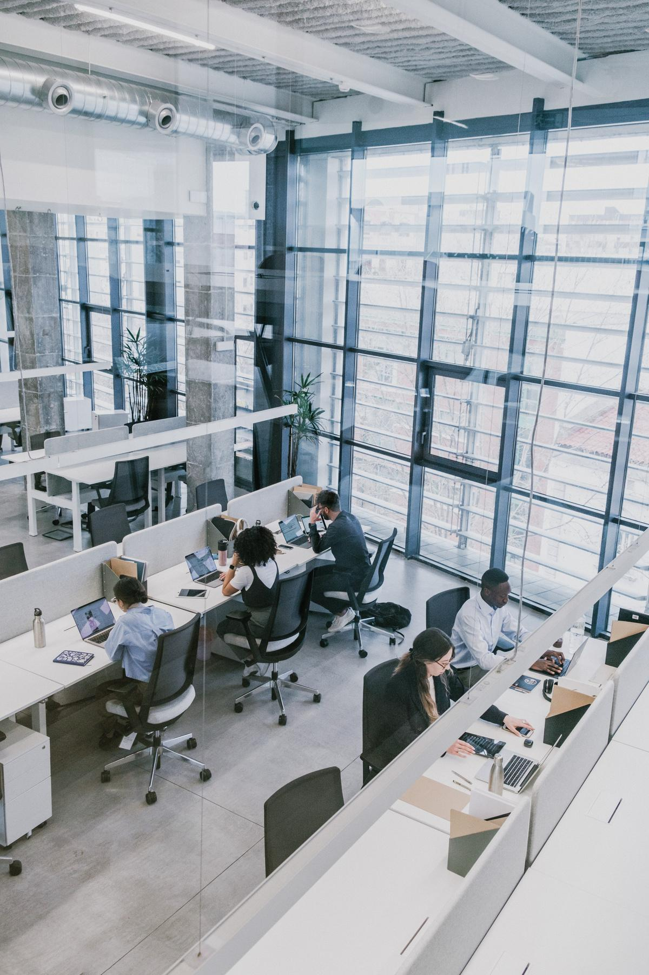





Project Objectives
Objective 01
Objective 02
Objective 03
Minimize time spent in queues and waiting for available tables., .
Ensure the availability of employees' preferred meal choices
Ensure employees eat at designated lunch hours
Objective 04
Objective 05
Objective 06
Implementing an online ordering system, ensuring timely meal delivery, and streamlining the payment process.
Reduce daily food waste by aligning food preparation with employee preferences.
Optimize inventory management to maintain accurate stock levels and reduce overproduction.

Slide 13
1
SURVEYS & INTERVIEWS
Some employees suggested to eat out during lunch hour.
Some opted for food delivery to them from external food vendors.
Others requested for an upgrade in the current canteen operations whereby, they can pre-order their meal and they get to access what they want and not what is available and reduce time wasted during lunch break.
Finding New Implementation
OBSERVATION
2
We observed how the current canteen ordering process is carried out to ascertain the problems that need to be addressed.
We noted huge food wastage as a result of their inability to get the staff what they want to eat.
3
RESEARCH
Researched on trending and innovative food ordering systems currently implemented in large companies.

Slide 14
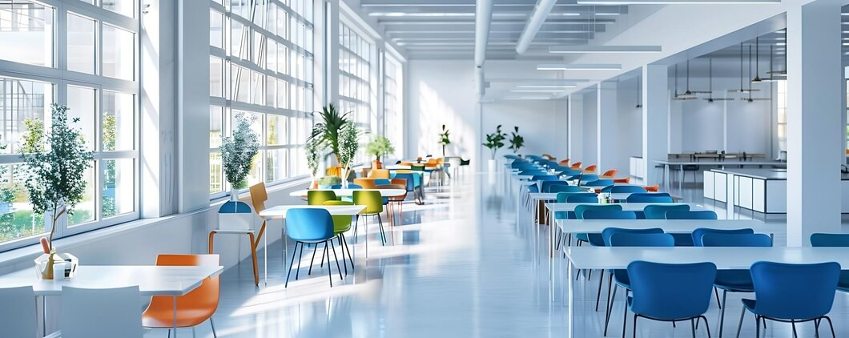
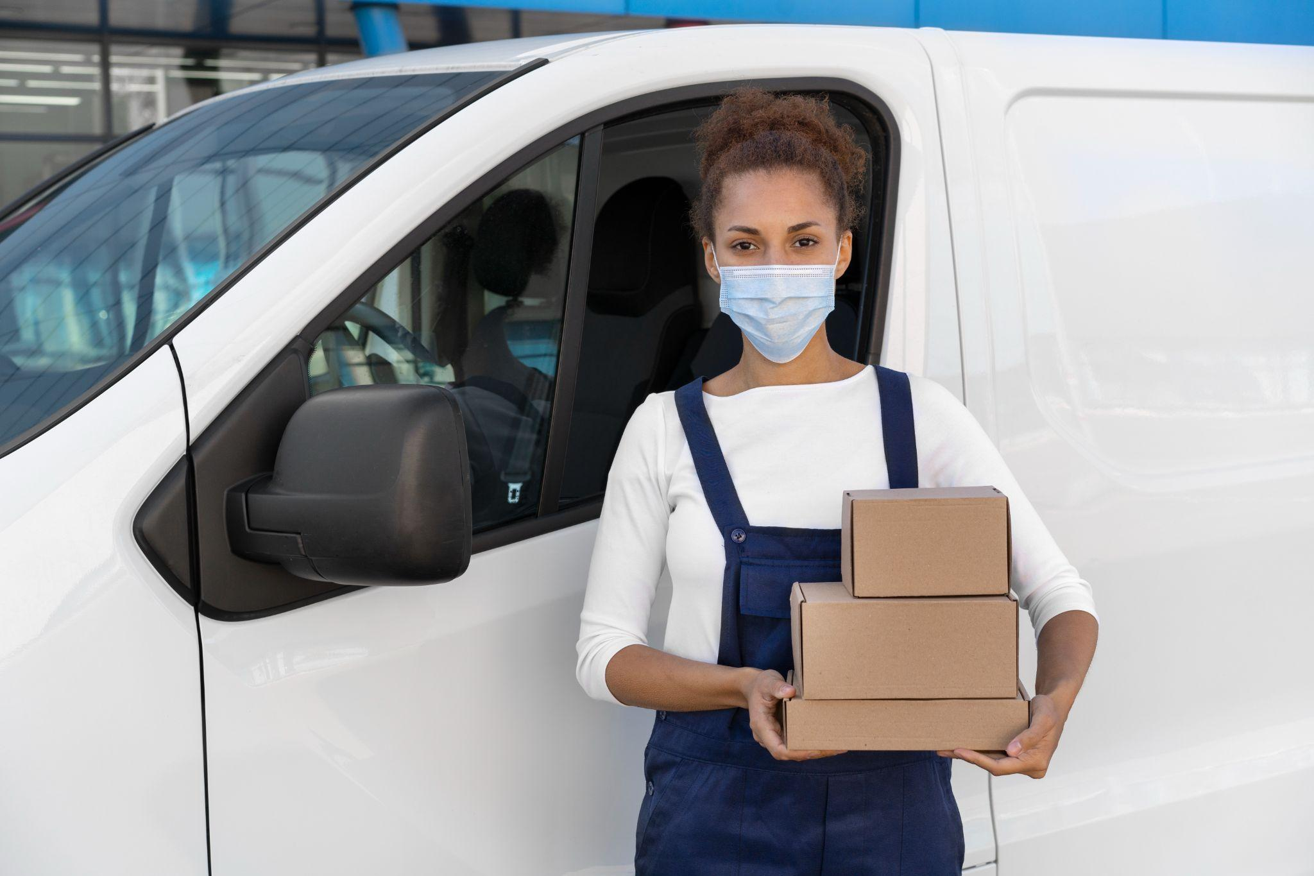
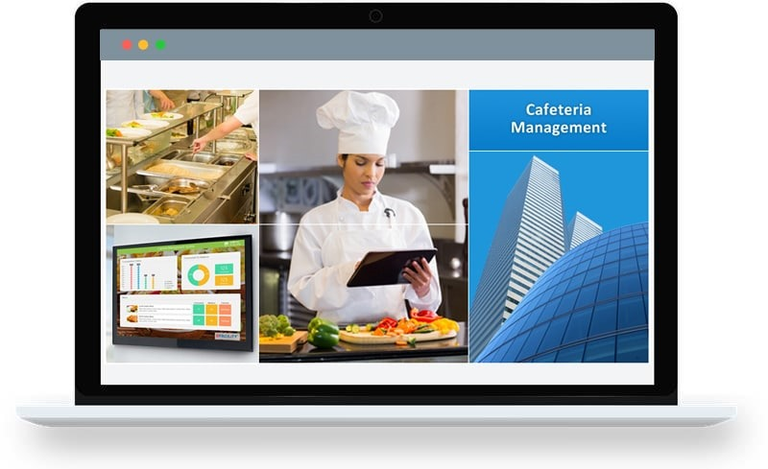
Review of Options
Canteen Expansion Project
Food delivery from external food Vendors
In-house Online Canteen ordering system (Selected)
Cost Intensive
Does not address issue of limited food choices for employees
Risk of food poison and general food hygiene issues
Risk of food delay and limited choices
Less cost intensive
Short time to market execution
Automated ordering process flow
Supports data driven planning

Slide 15
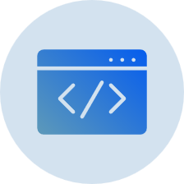

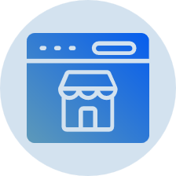
Possible Vendors for Canteen ordering System
Mealshift
Deliverect
Unilever IT Department
MealShift is an innovative food delivery platform and software company that gives restaurants/canteens back control. It offers a flexible and margin-improving ordering and delivery solutions that allows restaurants to reclaim power over their business.
MealShift provides restaurants with all the tools to sell directly to their customers and manage their own deliveries.
Deliverect UK is an all-in-one platform that streamlines the ordering and delivery process for restaurants. It integrates with a wide range of online ordering platforms and POS systems, and offers a variety of features to help restaurants manage their online ordering, delivery, and marketing efforts
Unilever UK IT department is made of a team of licensed expert software developers, testers and trainers with the technical know how to deliver on project expectations
Selected

Slide 16
Benefits of Canteen Ordering System
The new canteen ordering system will offer the following benefits;
1
Increased Productivity
By minimizing time spent on lunch-related activities, employees can focus on their work, leading to increased productivity.
Improved Employee Satisfaction
Reduced waiting times, increased food choices, and convenient meal delivery will enhance employee morale and satisfaction.
2
Reduced Food Wastage
Accurate demand forecasting through the online ordering system will help reduce food wastage, resulting in cost savings.
3
Optimized Canteen Operations
The system will provide valuable data on food preferences, enabling better menu planning and resource allocation.
4
The system will gather data on employee food choices, allowing for targeted marketing and promotional activities.
5
Enhanced Data Collection

Slide 17
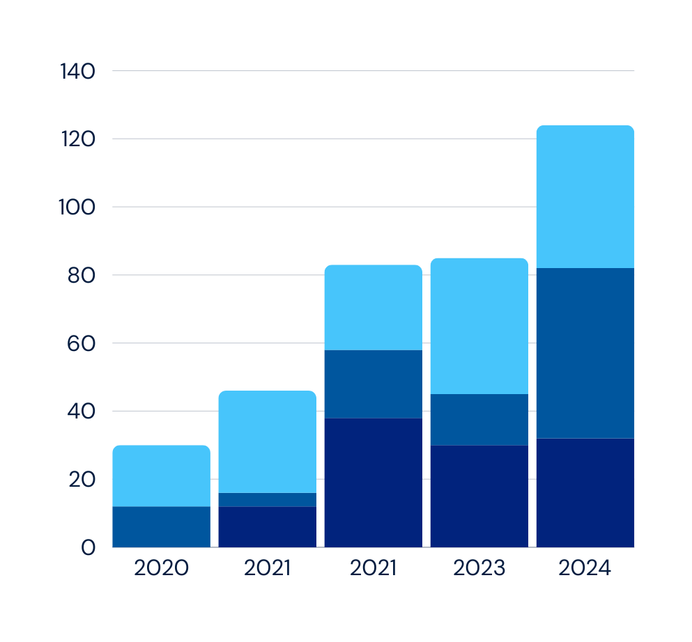
Key Performance Indicators
KPIs
Total number Feedback/complaints from Employees
By tracking these KPIs, Unilever will gain insights into the performance of the online food ordering system, identify areas for improvement, and make data-driven decisions to optimize the system.
60%
8.5/10
Average Order Processing Time reduction
Customer Satisfaction Ratings
70%
50%
Food Wastage Reduction
Increase in Employee Satisfaction Scores
Complaints
Return on Investment (ROI): Achieve a positive ROI within one years of system implementation.
Suggestions/feedback
Enquiries

Slide 18
Operational Challenges of this ordering system are:
1
Efficiently processing and fulfilling orders within specified delivery times can be challenging.
Technical Challenges during system integration (Can be complex and time consuming) and reliability (Downtime on the ordering portal).
Implementation Risks
2
3
System Usability: Ensuring the system is user-friendly for both employees and canteen staff can be a problem to the people who are not tech- savvy.
4
Initial Investment: The cost of implementing the system, including hardware, software, and integration, is significant.
5
Ongoing Costs: Maintaining and updating the system will increase the operational expenses.

Slide 19
Suggested Vendor Overview
Vendor
IT Department of Unilever UK will handle the implementation and integration of the canteen ordering system.
Costs associated with ordering software, system installation and integration -
Software procurement - £ 15,000
Installation cost - £ 7,500
Maintenance cost - £2,500 (Annually)
Total estimated cost - £25,000
Cost
Technology Migration
The current 1,500 Staff will be onboarded in 3 phases of 500s. Once the ordering process commence full operations, system downtime has a 3% likelihood of occurring. During downtime days, the canteen Manager is expected to get staff ordering via the canteen’s WhatsApp group. In addition, for days maintenance of the software has to be carried out, the employees make use of the whatsapp group chat.
Project Duration 15 weeks
System selection and procurement – 1 week (5 working days)
Development of Software – 12 weeks
Pilot testing and refinement – 1 week (5 working days)
Employees training and communication – 1 week (5 working days)
Go live – 25th Nov. 2025
Implementation Program

Slide 20
Conclusion
Implementing an online food ordering system at Unilever’s UK office is a strategic investment that will deliver significant benefits to both employees and the organization. By addressing the current challenges in canteen operations, this system will enhance employee satisfaction, improve employees productivity, reduce wastage and inefficiencies in the canteen operation.

Slide 21

Unilever Canteen ordering System Development

Slide 22
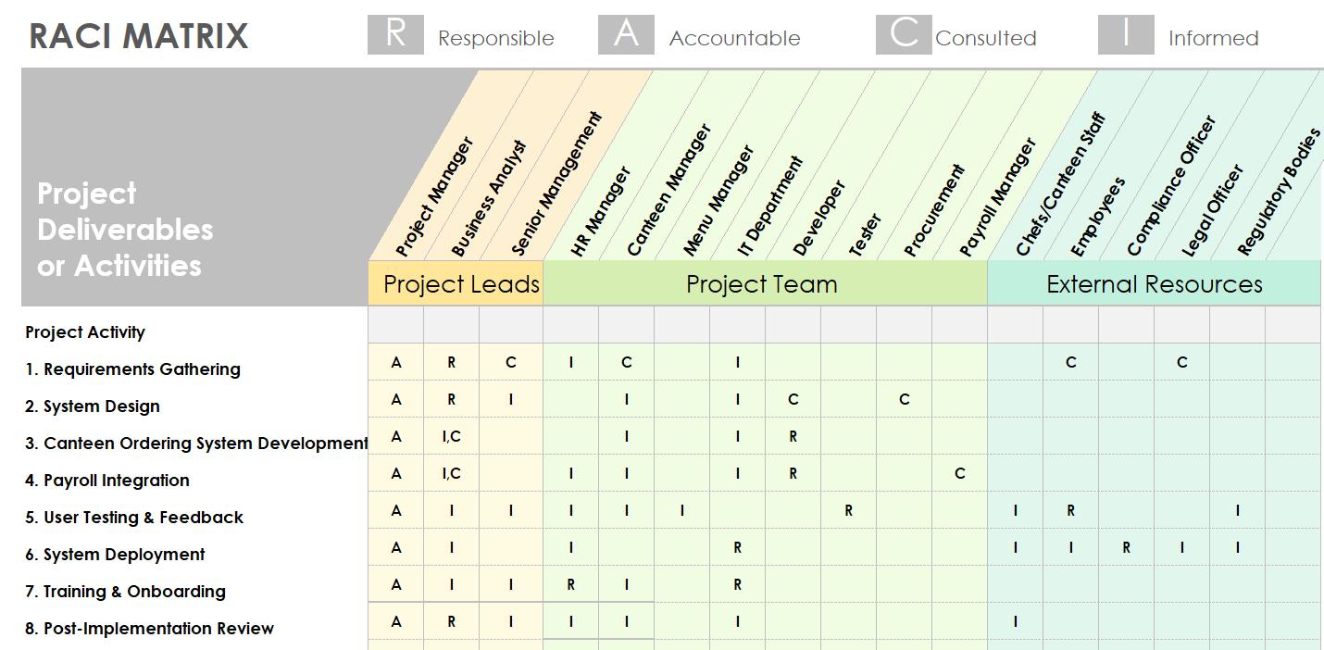
I

Slide 23
Main Software Features to be Developed
User Interface (UI) for Employees
Menu
Management
Order
Processing
Account creation and modification
Daily Menu
Order Placement System Display
Order History
Menu Creation and Update
Demand Forecasting Tool
Notification for orders
Order Tracking
Inventory management
Order Scheduling
Delivery Management
Payroll
Integration
Feedback and Reporting
Payroll Deduction Enrollment
Automatic Payroll Deduction
Order Summary Reports
Employee Feedback Portal
Analytics Dashboard
Delivery Request
Delivery Assignment
Delivery Confirmation

Slide 24
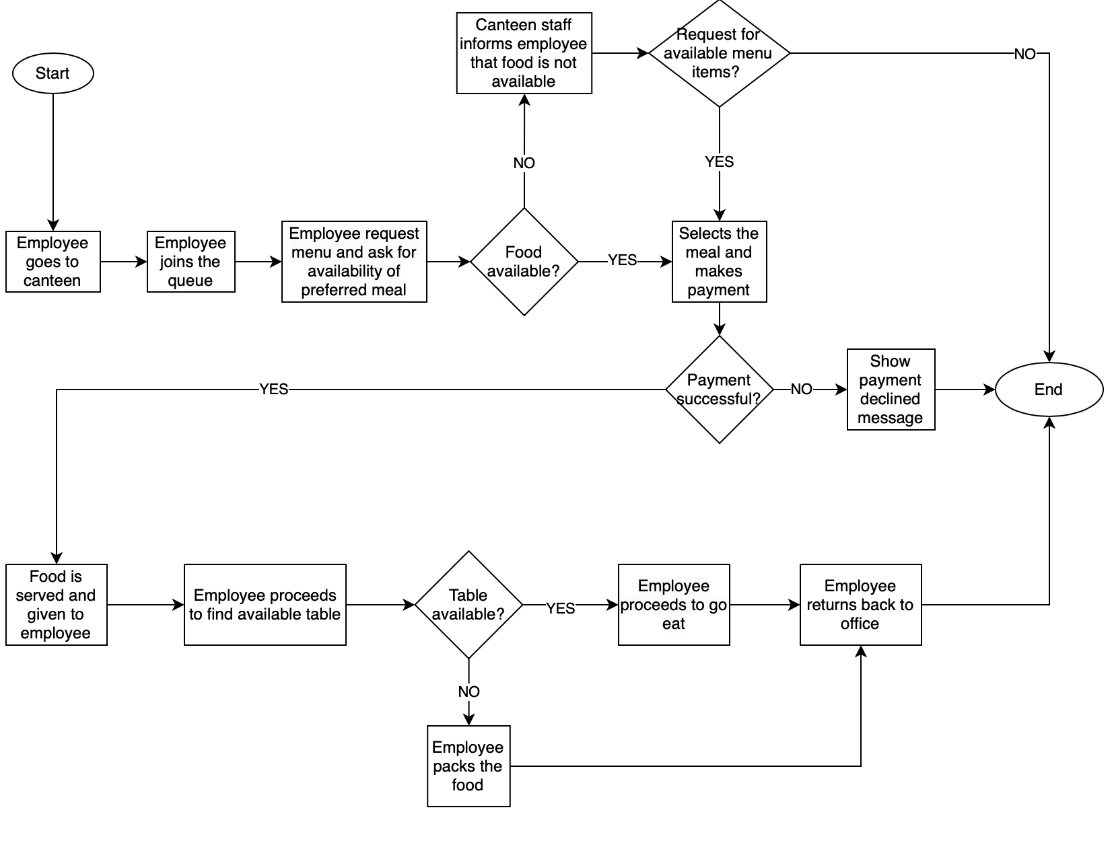
AS-IS PROCESS MAP

Slide 25
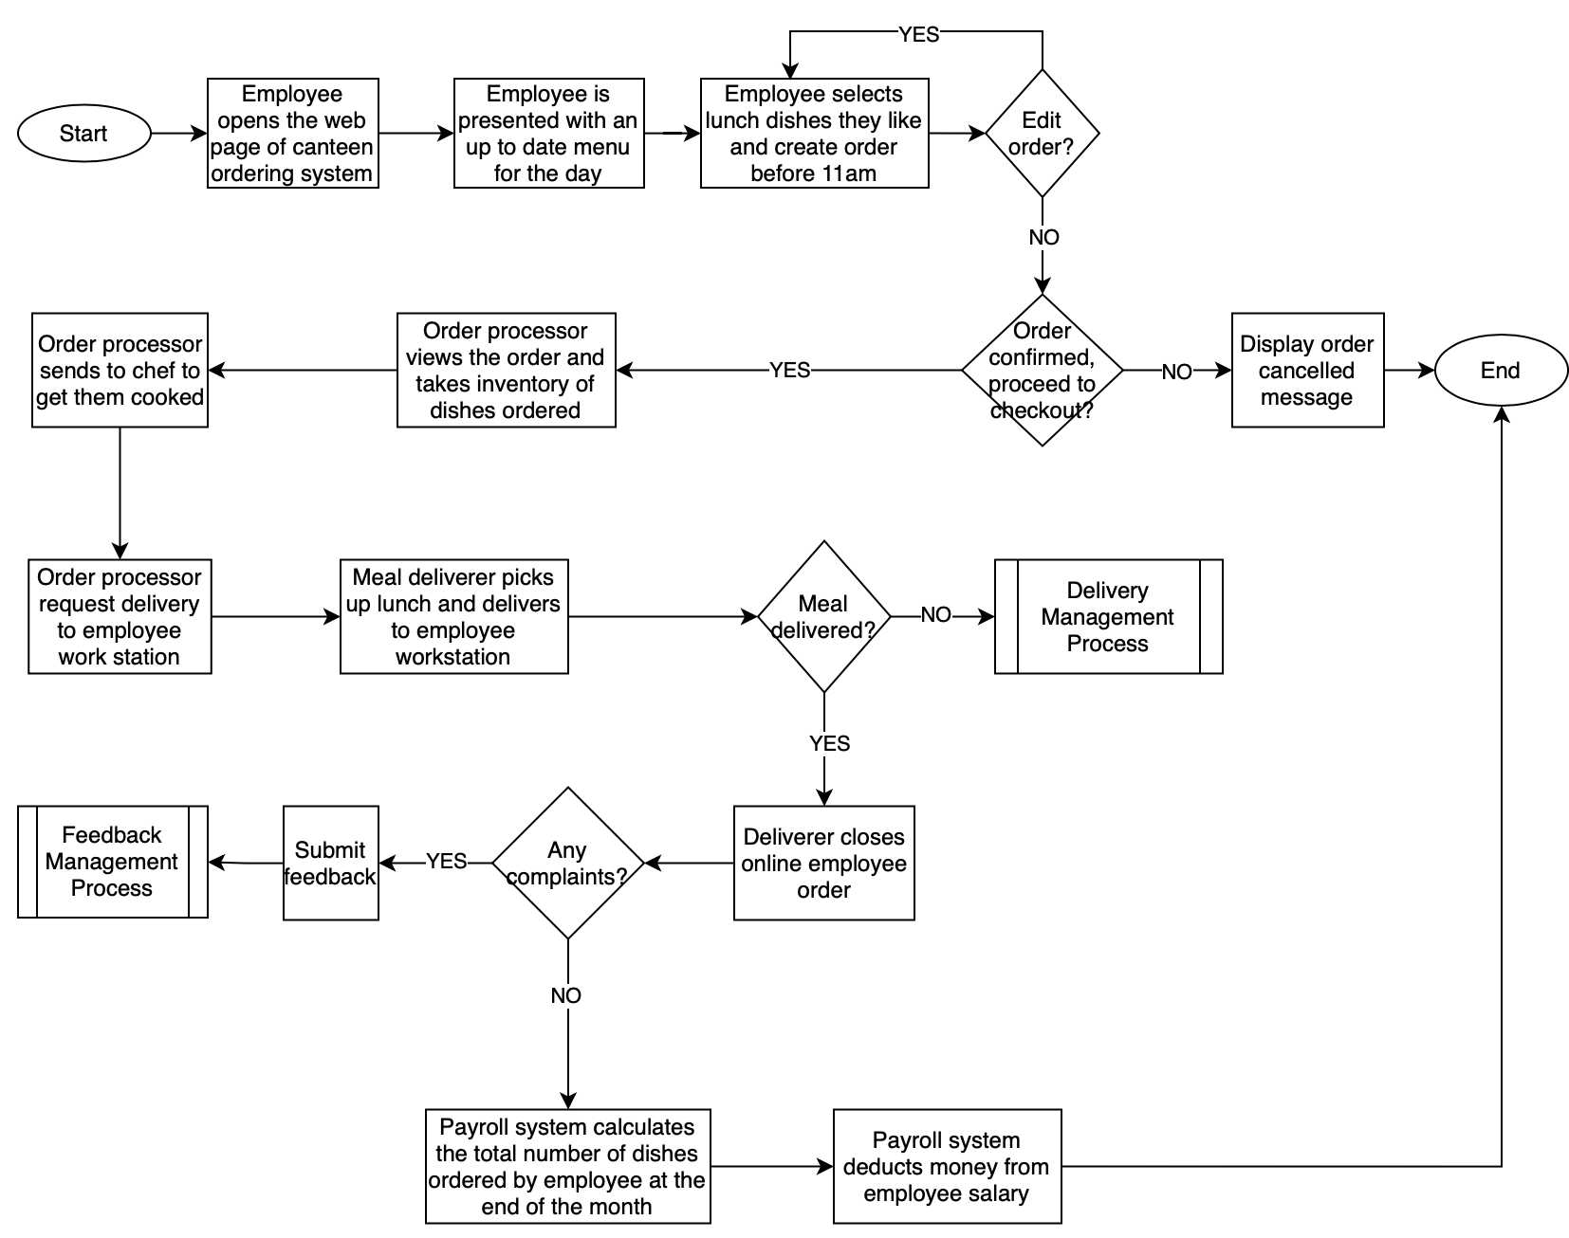
T0-BE PROCESS MAP

Slide 26
Unilever User Stories
EPIC 1 - ORDER PLACEMENT
As an employee, I want to be able to log into the Canteen ordering system, so that I can view the daily menu
As an employee, I want to be able to choose from the daily menu and select my meal, so that I can place an order.
As a canteen manager, I want to view and process orders, so that I can coordinate with the kitchen.
EPIC 2 - MENU MANAGEMENT
As a menu manager, I want to create the daily menu, so that employees can see available options.
As a menu manager, I want to update menu items and prices, so that the system reflects the latest information.
As an employee, I want to suggest a new dish to the menu, so that my favorite food can be offered.
As an employee, I want to rate the dishes I have tried, so that the canteen can improve the menu based on employee feedback.
As a canteen manager, I want to receive suggestions from employees about the menu, so that I can improve the food offerings
EPIC 3 - PAYMENT AND FINANCIAL MANAGEMENT
As an employee, I want my meal cost deducted from my salary, so that I don't have to pay upfront.
As a payroll manager, I want to receive meal cost data, so that I can deduct it from employee salaries.
As a canteen manager I want to identify employees with unpaid meal orders, so that I can follow up on outstanding payments.
As a canteen manager I want to be able reconcile meal order totals with payroll deductions, to ensure accurate financial reporting.

Slide 27
Unilever User Stories
EPIC 4 - DELIVERY MANAGEMENT
As an employee, I would like to have an option to enter my office address, so that I can have my meal delivered to my desk.
As a delivery person, I want to receive delivery assignments, so that I can deliver meals to employees.
As the employee, I want to be able to see when my order has been collected from the kitchen by the deliverer, so that I can be able to track them.
EPIC 5 - ORDER TRACKING
As an employee, I want to be able to see the time my order is accepted, so that I can be sure my order went through.
As the canteen manager, I should be able to provide an order confirmation with relevant details such as order number, so that I can use for future references.
As the employee, I want to be able to see the estimated delivery time, so that I can be able to see whether it would be delivered before my lunch break is over or not.
EPIC 6 - FEEDBACK MANAGEMENT
As an employee, I want to be able to provide feedback on the food and delivery service, so that the canteen can improve.
As an employee, I want to suggest improvements to the canteen's operations, so that the canteen can enhance the overall dining experience.
As a canteen manager, I want to view and analyze feedback, so that I can identify areas for improvement.
As a canteen Manager, I want to generate reports on feedback, share with management so that I can identify improvement opportunities.

Slide 28
JIRA Sprints and Timelines

Slide 29
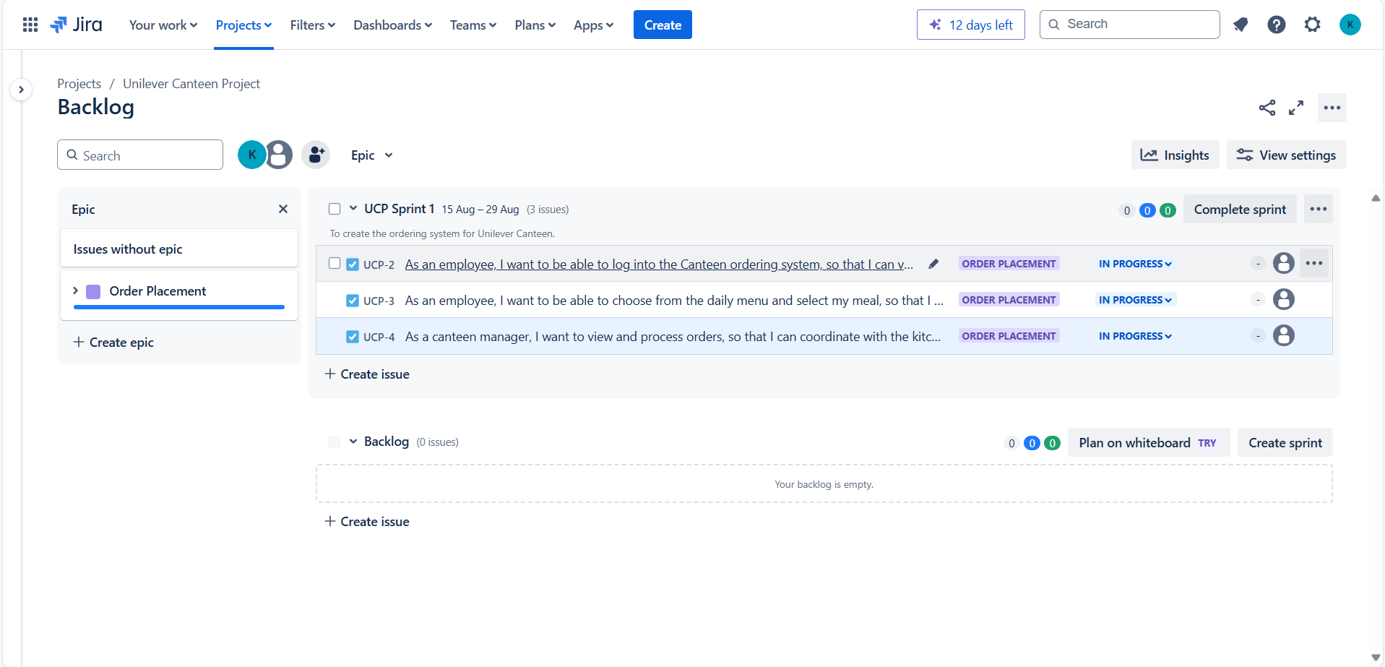
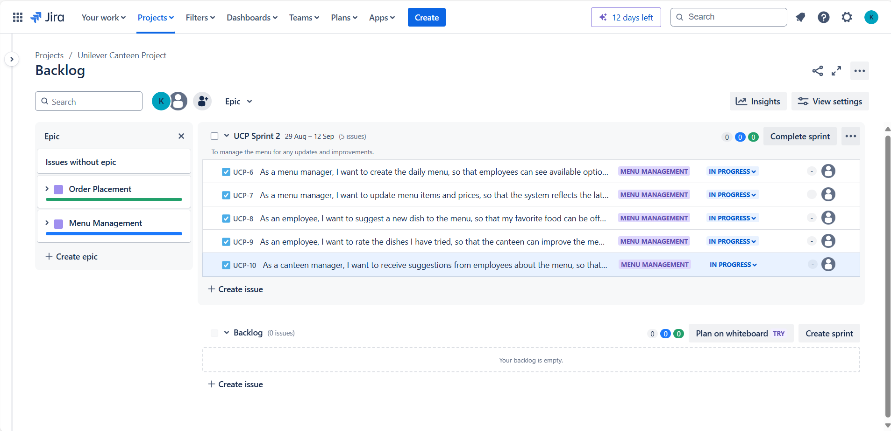
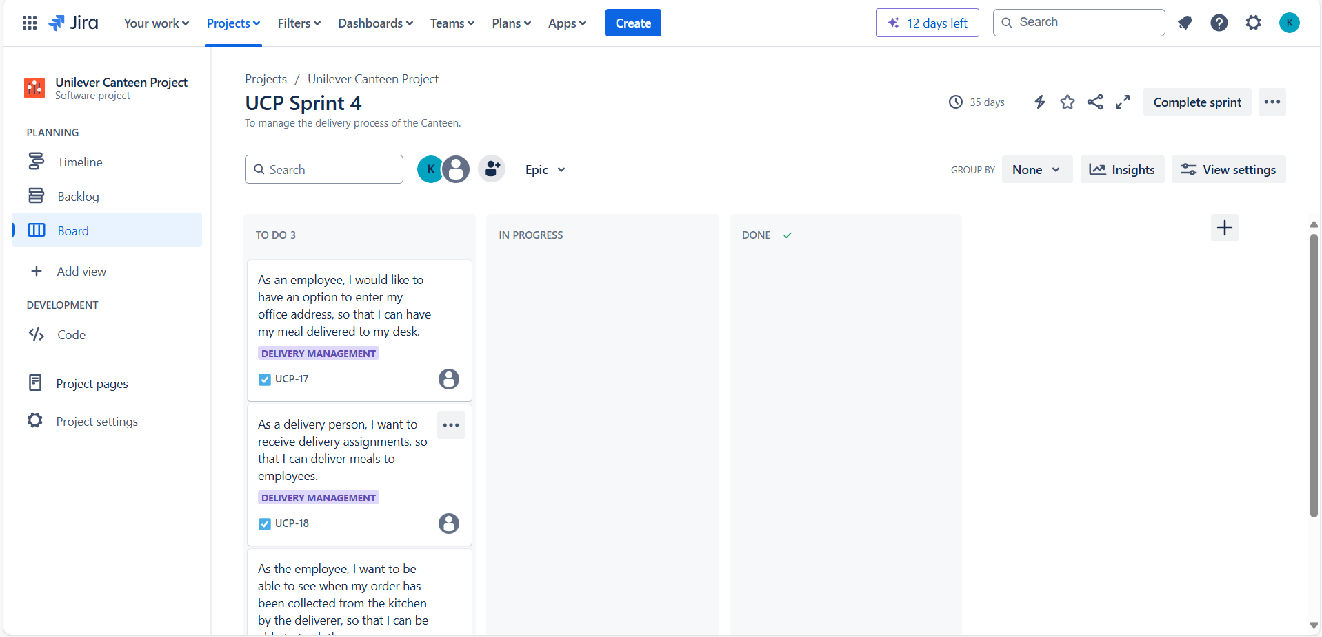
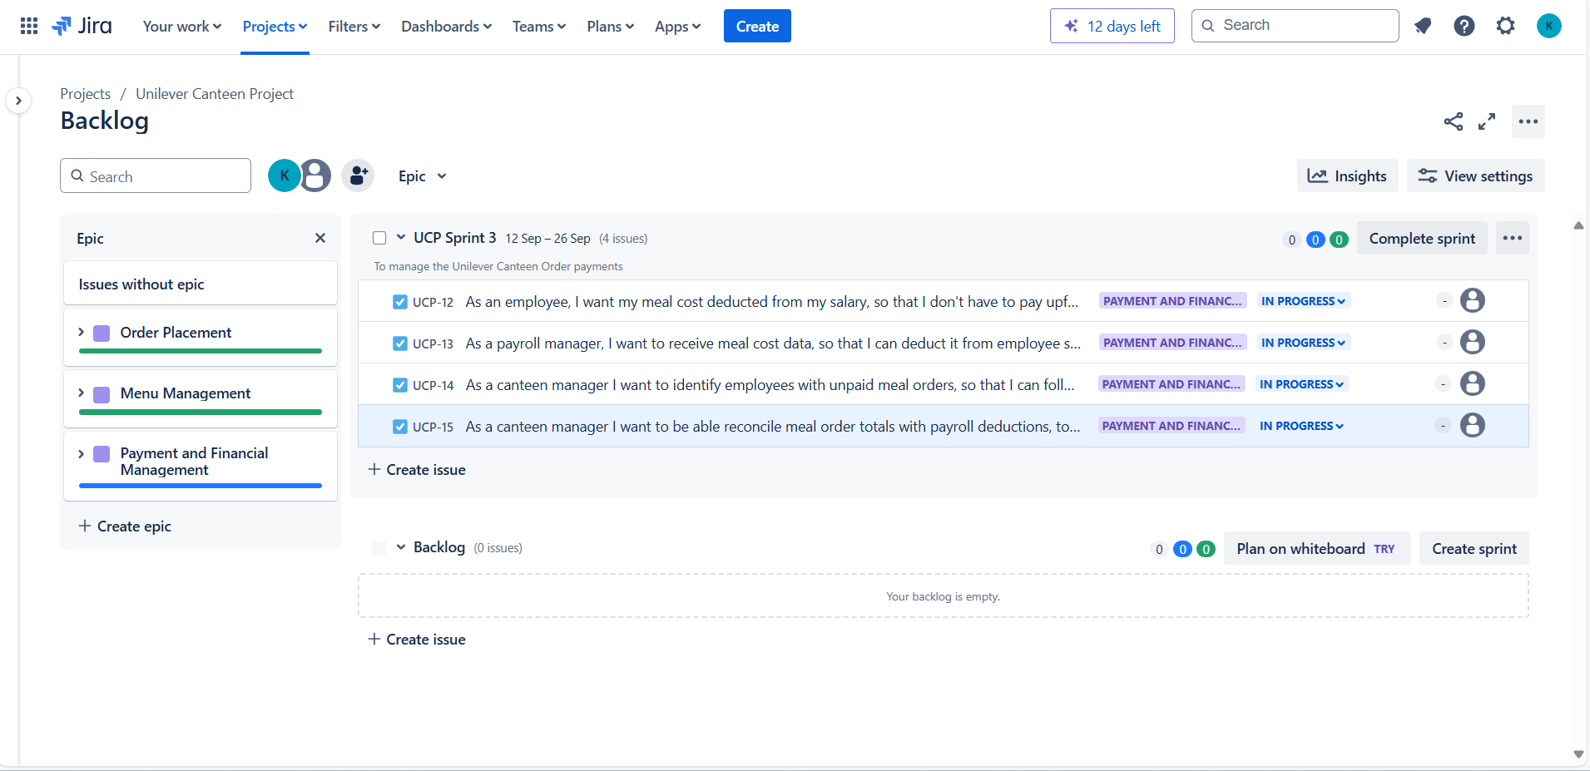
JIRA Sprints

Slide 30
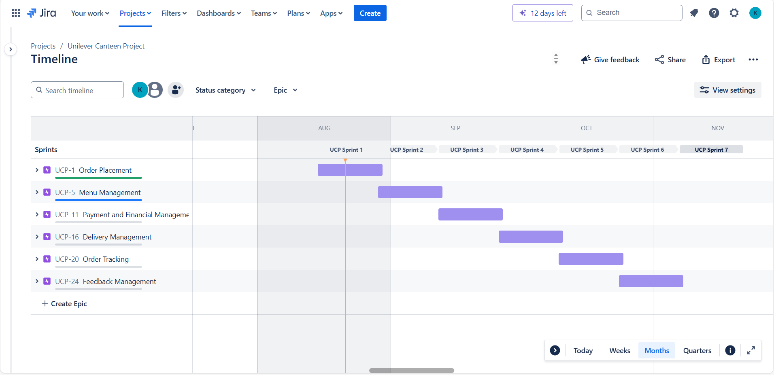
JIRA Timeline

Slide 31
Our Team
Team Leader
Dzidzo
Kumahor
Amarachi Odoemenam
Skota Kearabetse
Ayobami
Ojo
Aliyu
Ibrahim
Adetutu Makinde
Oluwatosin Oyewusi
Olamide
Fadairo
Omogbonjubola Ogedengbe
Oscar
Odiboh
Olaleye Ademola Makanjuola
Ehiagwina Adesomo Ederibhalo

Slide 32
THANK YOU!

